Slide 1


Hello!
How are you?
What are you feeling today?

Slide 2



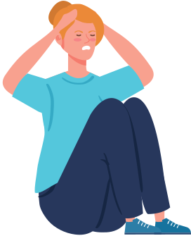
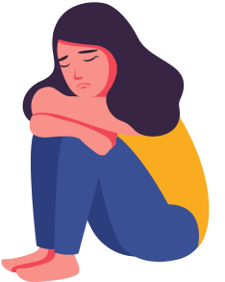

Mental Health and Youth
THE CURRENT PROBLEM
Increase in suicide, anxiety, and depression among youth
Inability to identify emotions
Disrupted psych services

Slide 3
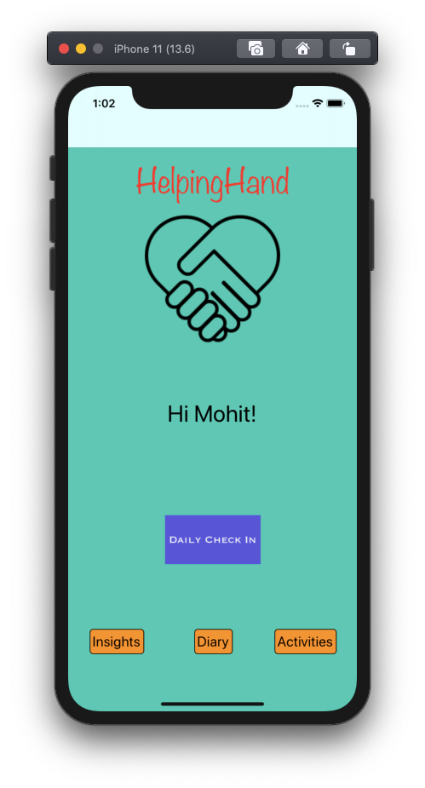

HelpingHand
Mobile Application that monitors and builds emotional wellness through emotional awareness
HUMANITY 101 PRINCIPLES
Integrity | Compassion | Empathy | Self-reflection

Slide 4

Emotional safe space that is timely and responsive
Youth as emotionally intelligent and responsible
Leverage youth's digital presence to check on their emotional health
Lessen the burden of mental health professionals

Slide 5

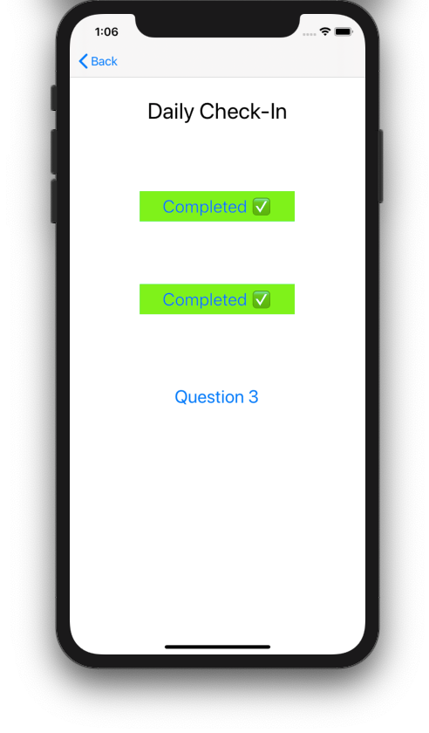
Our Solution in 3 easy steps!
Emotions tracker and habit builder

Slide 6


Revenue Model
FREE
Distribution of aggregated data anonymized to protect user identity to third-parties
Disclaimer: not a replacement to psych tests and treatments

Slide 7
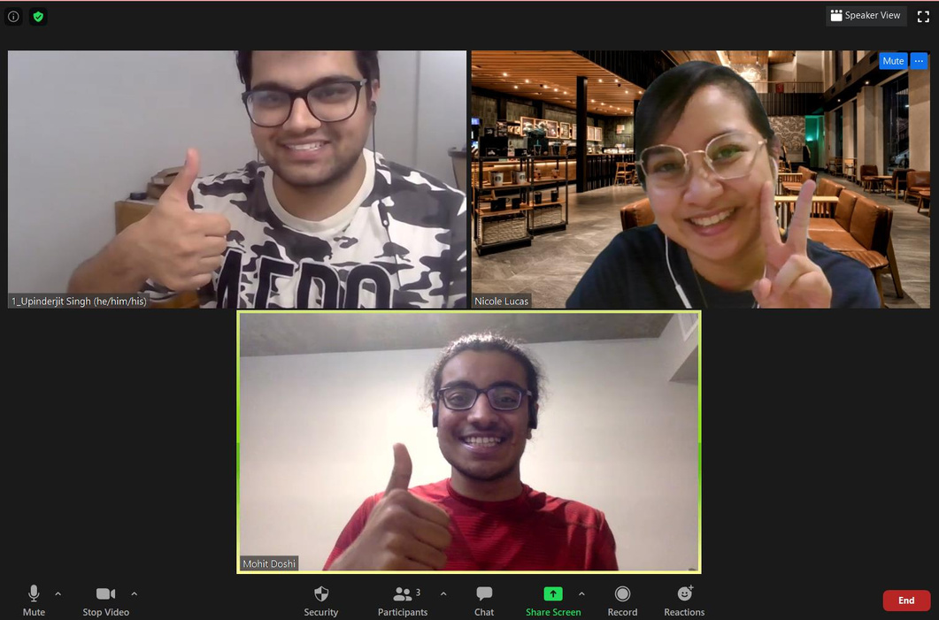
The Team
Nicole Lucas
Upinderjit Singh
Philosophy Major
Project Management Specialist
Computer Science Major
Programmer
Mohit Doshi
Computer Science Major
Programmer

